Slide 1





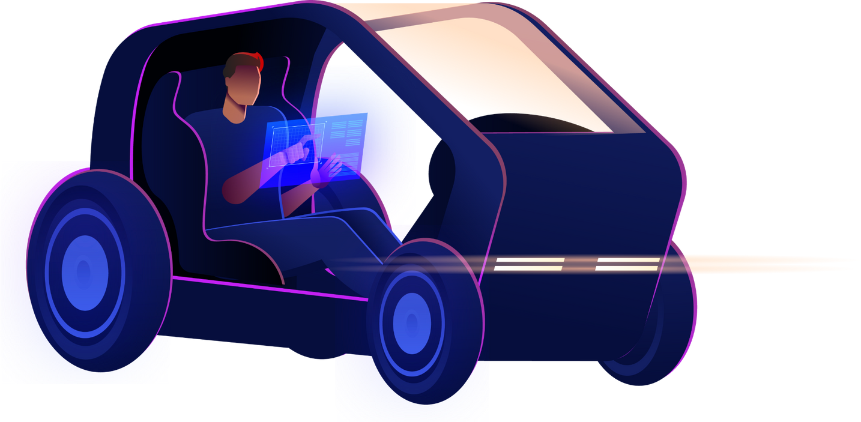


Reinforcement Learning in the
Transportation Sector : Autonomous
Vehicle
Framed By
Pr. Kadiri
Presented By
Abdelouahab Bella

Slide 2





01
Table of contents
01
Introduction
DDQN
04
02
Background
Results & discussions
05
03
Problem & Solutions
Conclousion
06

Slide 3
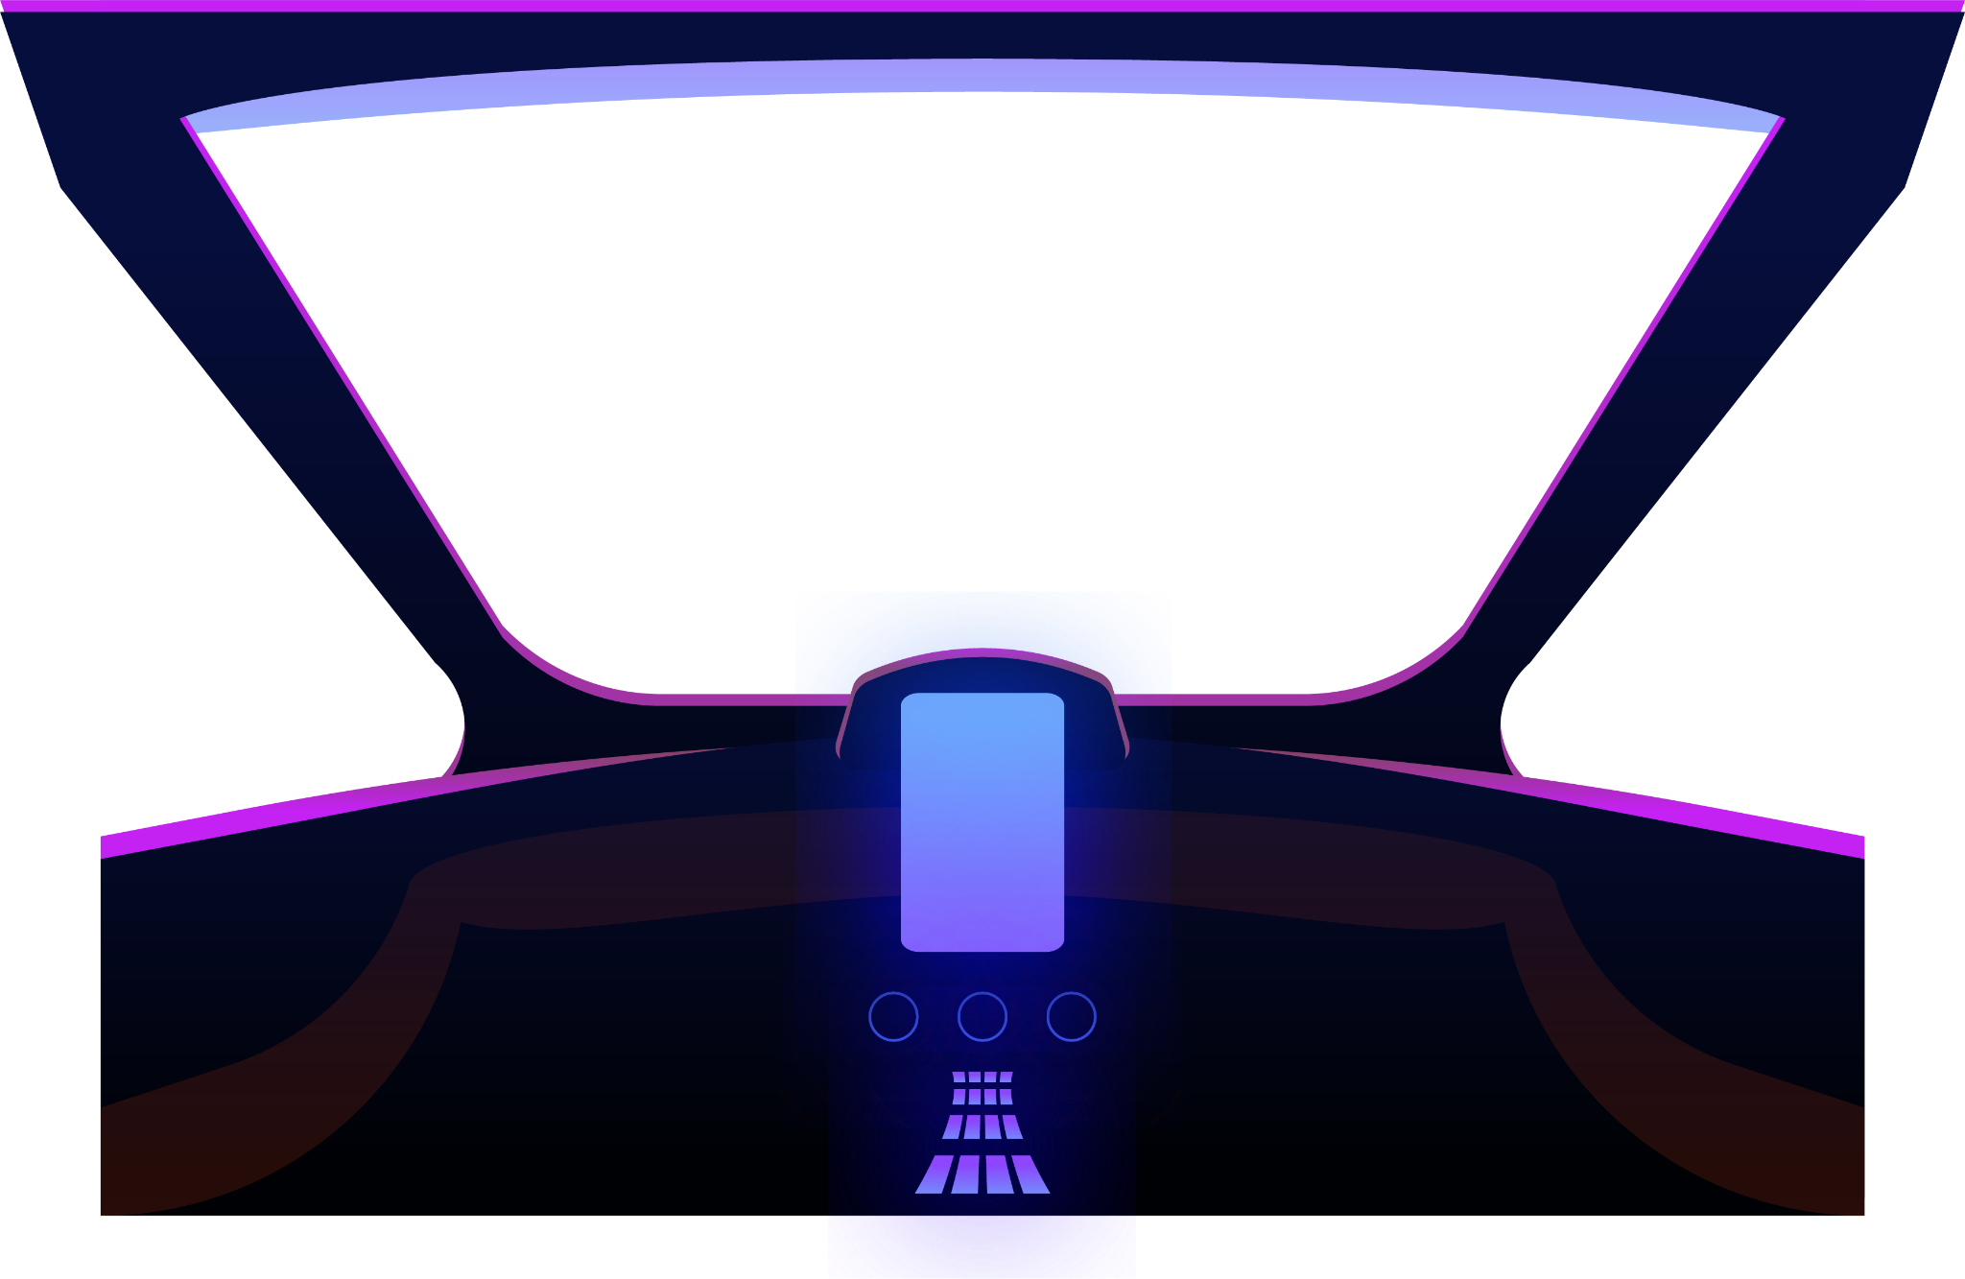



02
01
Introduction

Slide 4
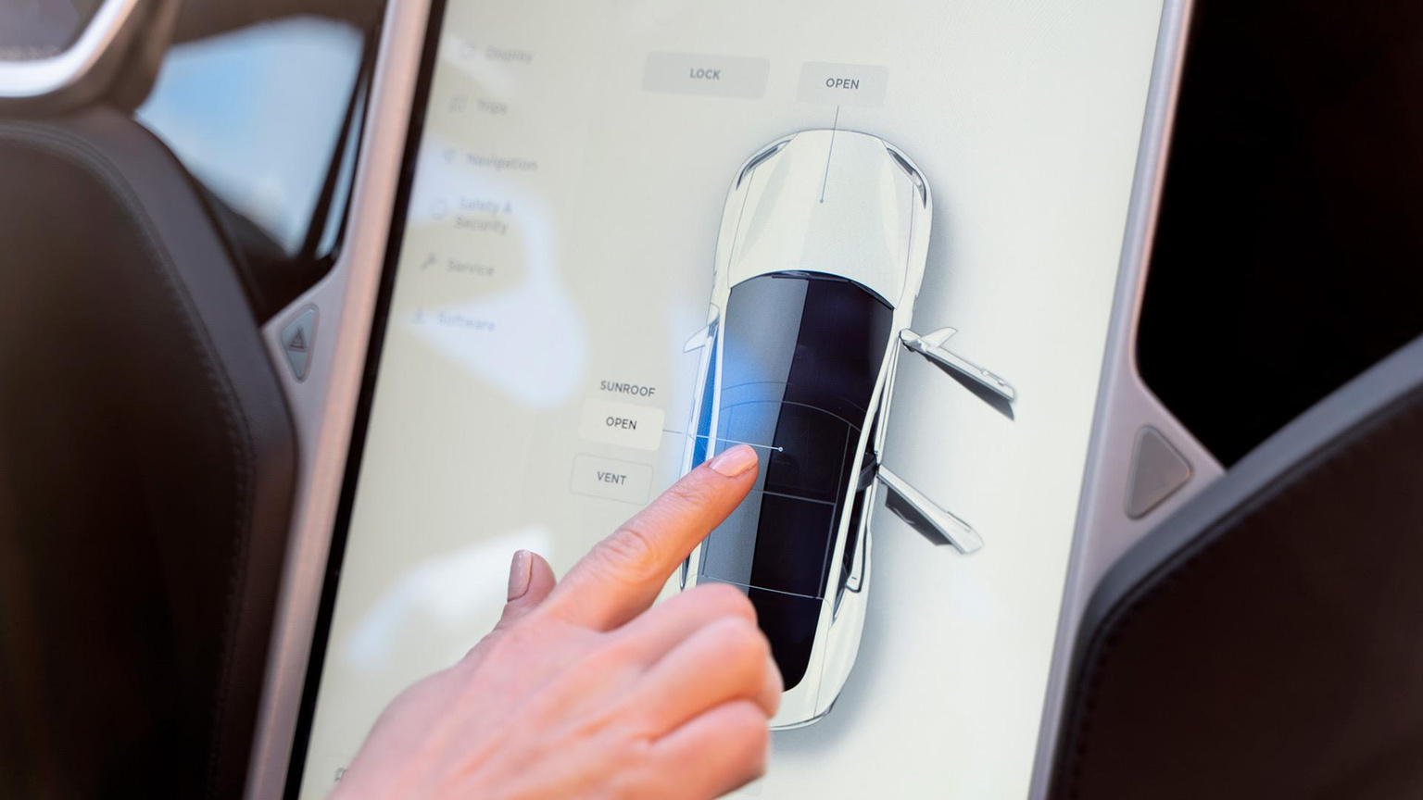
03
Background
Some History
Experiments have been started on automating cars since 1920.
First experimental vehicle took place in 1950.
The first self-sufficient and truly autonomous car appeared in 1980.

Slide 5
04
Background
LET'S TALK ABOUT FUTURE
Waymo -- Zoox -- Nvidia
They are really good in what they are doing
maintain trust in the safety of autonomous vehicles,

Slide 6
05
Problem & Solutions
Model In the Cloud
5G connection
Production Model Size
DDQN

Slide 7

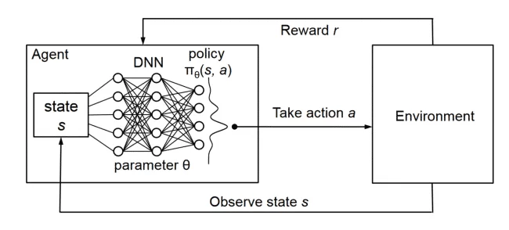
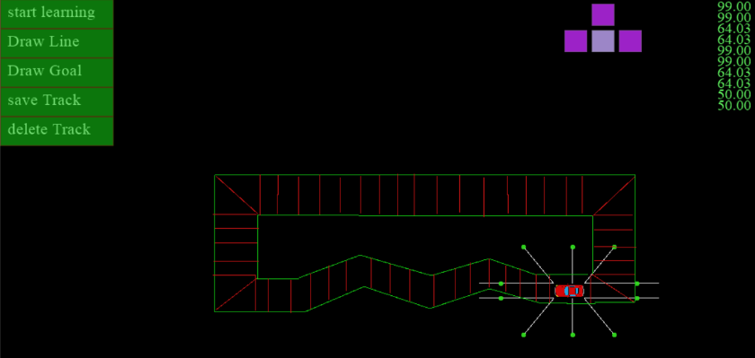

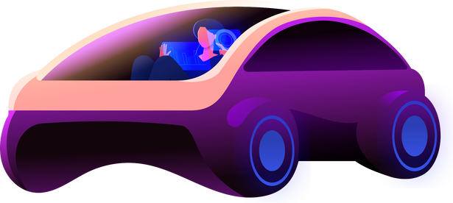
06
DDQN In Depth
Deep Reinforcement Learning & DDQN
Deep Reinforcement Learning (DRL) combines deep learning and reinforcement learning to train neural networks for optimal decision-making
Environments
Creating robust simulation environments for autonomous vehicle AI using Pyglet framework.

Slide 8
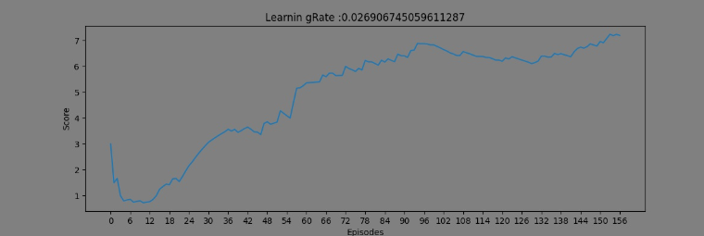


07
Results & Discussions
Scalability
Efficiency
Precision

Slide 9
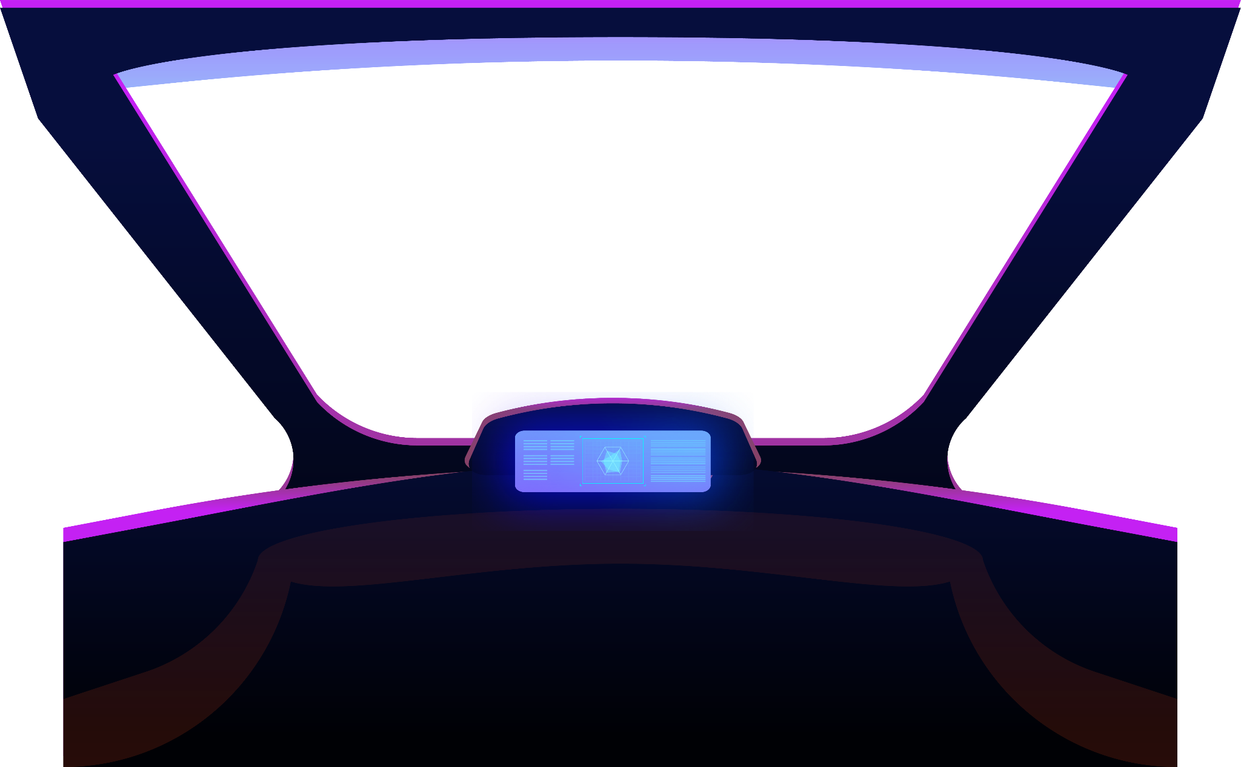


Thank You For You Attention

